Slide 1
MSDM 5003 Lecture 8 26 October 2021 Wealth Distribution
Outline:
9.1 Kinetic theory of gases
9.2 The asset exchange model of wealth distribution
Random sharing model
Model with uniform savings
Model with non-uniform savings
9.3 Comparison with real data
9.4 A minimal model of interacting selfish agents

Slide 2
9.1 Kinetic Theory of Gases
Exploring Complex Distributions with Simple Models (Econophysics Chapter 8)
Complex distributions: macroscopic
Simple models: microscopic agent-based models
The approach of using a molecule-based model to explain macroscopic phenomena is best illustrated by the kinetic theory of gases, which explains the distribution of energy of molecules.
Subsequently, we will adopt this approach to explain the distribution of wealth.

Slide 3
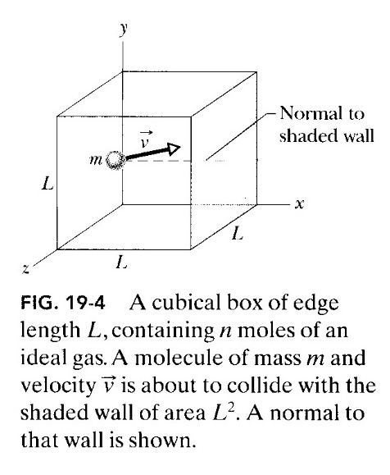
Kinetic Theory Explaining Pressure
Consider n moles of an ideal gas in a cubical box of volume V at temperature T.
The gas molecules are moving in the box.
When they collide with the walls, the collision is elastic and momentum is transferred to the walls.
Using Newton’s second law, this change in momentum results in a force acting on the wall.
This force contributes to the pressure of the gas.

Slide 4
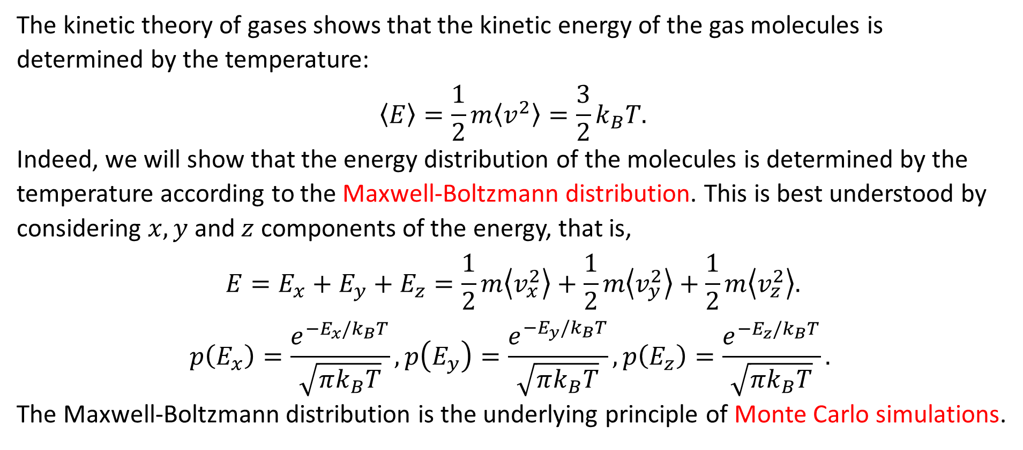
Relating Temperature with Molecular Energy
The kinetic theory of gases shows that the kinetic energy of the gas molecules is determined by the temperature:
$$〈E〉=\frac{1}{2}m〈v^{2}〉=\frac{3}{2}k_{B}T.$$
Indeed, we will show that the energy distribution of the molecules is determined by the temperature according to the Maxwell-Boltzmann distribution. This is best understood by considering $x, y$ and $z$ components of the energy, that is,
$$E=E_{x}+E_{y}+E_{z}=\frac{1}{2}m\left\langle v_{x}^{2}\right\rangle +\frac{1}{2}m\left\langle v_{y}^{2}\right\rangle +\frac{1}{2}m\left\langle v_{z}^{2}\right\rangle .$$
$$p\left(E_{x}\right)=\frac{e^{−E_{x}/k_{B}T}}{\sqrt{πk_{B}T}}, p\left(E_{y}\right)=\frac{e^{−E_{y}/k_{B}T}}{\sqrt{πk_{B}T}},p\left(E_{z}\right)=\frac{e^{−E_{z}/k_{B}T}}{\sqrt{πk_{B}T}}.$$
The Maxwell-Boltzmann distribution is the underlying principle of Monte Carlo simulations.

Slide 5
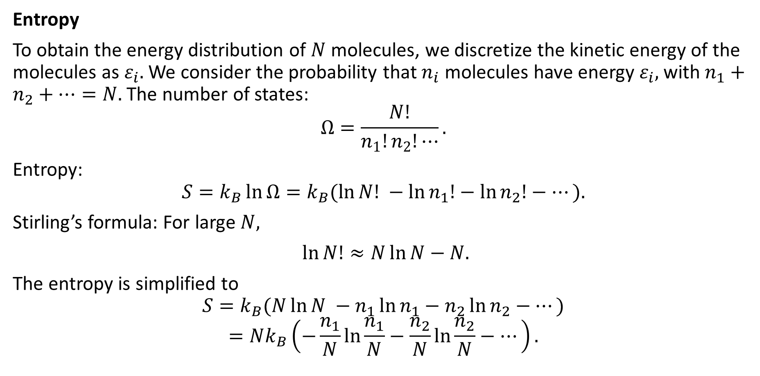
Energy Distribution: Maximum Entropy
Entropy
To obtain the energy distribution of $N$ molecules, we discretize the kinetic energy of the molecules as $ε_{i}.$ We consider the probability that $n_{i}$ molecules have energy $ε_{i},$ with $n_{1}+n_{2}+⋯=N.$ The number of states:
$$Ω=\frac{N!}{n_{1}!n_{2}!⋯}.$$
Entropy:
$$S=k_{B}\ln{Ω}=k_{B}(\ln{N! }−\ln{n_{1}!}−\ln{n_{2}!}−⋯).$$
Stirling’s formula: For large $N,$
$\ln{N!}≈N\ln{N}−N.$
The entropy is simplified to
$$S=k_{B}(N\ln{N }−n_{1}\ln{n_{1}}−n_{2}\ln{n_{2}}−⋯)$$
$$=Nk_{B}\left(−\frac{n_{1}}{N}\ln{\frac{n_{1}}{N}}−\frac{n_{2}}{N}\ln{\frac{n_{2}}{N}}−⋯\right).$$

Slide 6
An Analogy of Maximum Entropy: The Haunted Castle
The situation is like a drunken ghost wondering inside a haunted castle with many rooms of different sizes. (It can penetrate all walls.)
Even if he starts from a small room, he will most likely be located in the room with the largest area after a long time.
The largest room corresponds to the macrostate having the largest number of microstates.

Slide 7
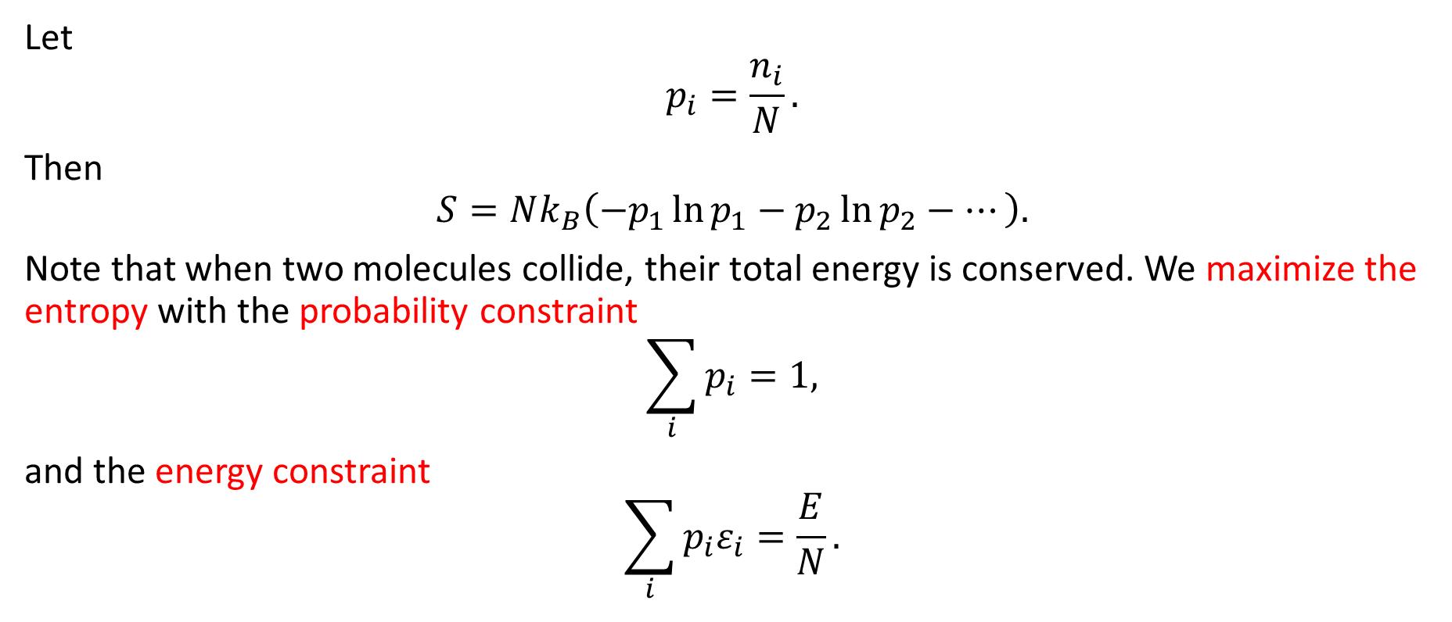
Boltzmann Distribution of Molecular Speeds
Let
$$p_{i}=\frac{n_{i}}{N}.$$
Then
$$S=Nk_{B}\left(−p_{1}\ln{p_{1}}−p_{2}\ln{p_{2}}−⋯\right).$$
Note that when two molecules collide, their total energy is conserved. We maximize the entropy with the probability constraint
$$\sum_{i}{p_{i}}=1,$$
and the energy constraint
$$\sum_{i}{p_{i}ε_{i}}=\frac{E}{N}.$$

Slide 8
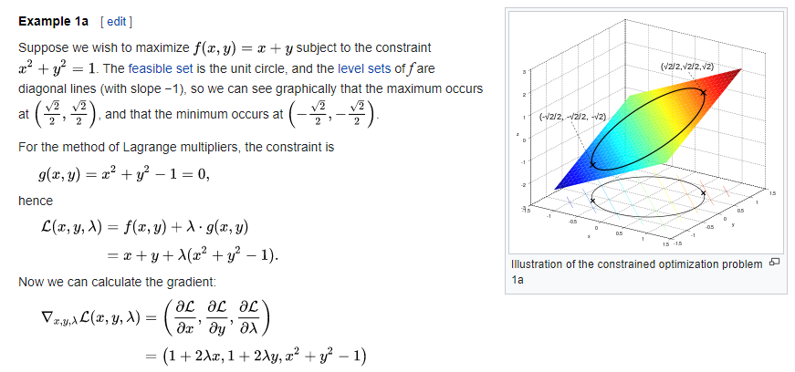
Method of Lagrange Multipliers
(from Wikipedia)

Slide 9
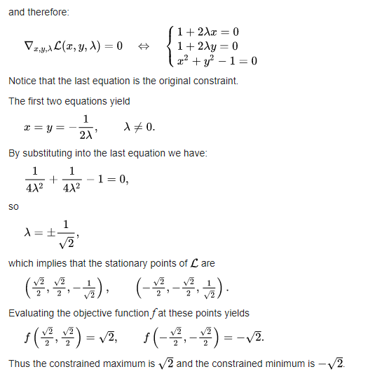

Slide 10
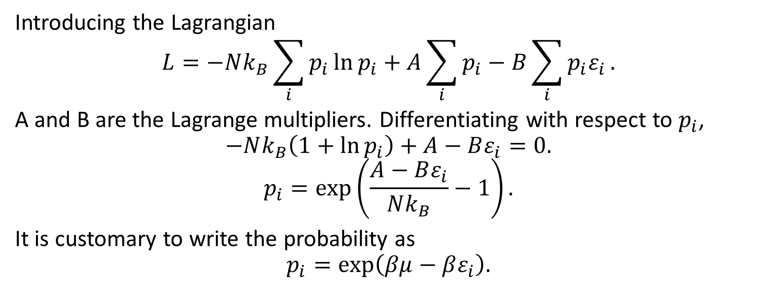
Constrained Maximization of Entropy
Introducing the Lagrangian
$$L=−Nk_{B}\sum_{i}{p_{i}\ln{p_{i}}}+A\sum_{i}{p_{i}}−B\sum_{i}{p_{i}ε_{i}}.$$
A and B are the Lagrange multipliers. Differentiating with respect to $p_{i}$,
$$−Nk_{B}\left(1+\ln{p_{i}}\right)+A−Bε_{i}=0.$$
$$p_{i}=\exp\left(\frac{A−Bε_{i}}{Nk_{B}}−1\right).$$
It is customary to write the probability as
$$p_{i}=\exp\left(βμ−βε_{i}\right).$$

Slide 11
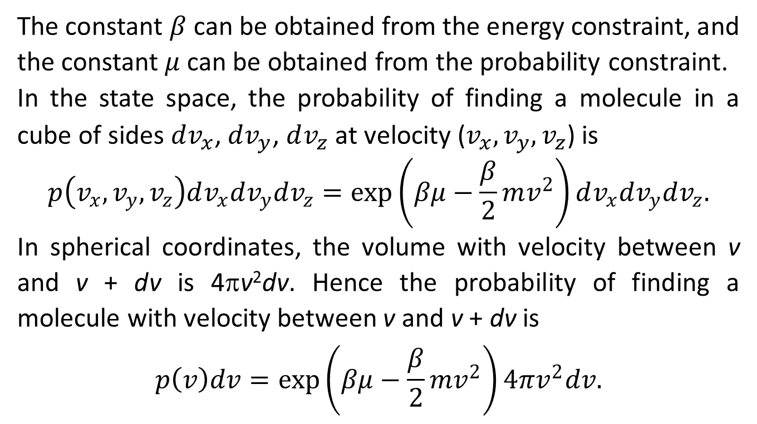
Finding Lagrange Multipliers by the Constraints
The constant $β$ can be obtained from the energy constraint, and the constant $μ$ can be obtained from the probability constraint.
In the state space, the probability of finding a molecule in a cube of sides $dv_{x}$, $dv_{y}$, $dv_{z}$ at velocity ($v_{x}, v_{y}, v_{z}$) is
$$p\left(v_{x},v_{y},v_{z}\right)dv_{x}dv_{y}dv_{z}=\exp\left(βμ−\frac{β}{2}mv^{2}\right)dv_{x}dv_{y}dv_{z}.$$
In spherical coordinates, the volume with velocity between v and v + dv is 4πv²dv. Hence the probability of finding a molecule with velocity between v and v + dv is
$$p\left(v\right)dv=\exp\left(βμ−\frac{β}{2}mv^{2}\right)4πv^{2}dv.$$
v_{z}
v_{y}
v_{x}

Slide 12
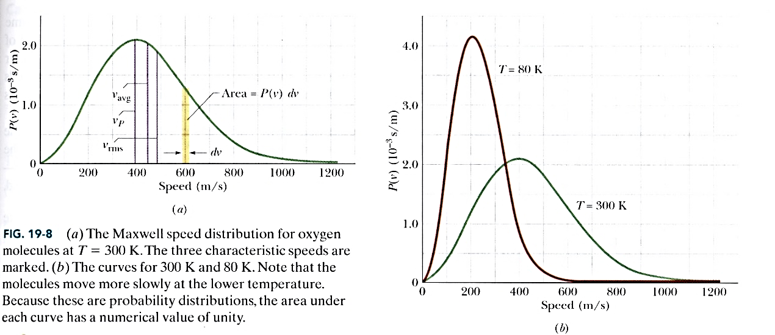
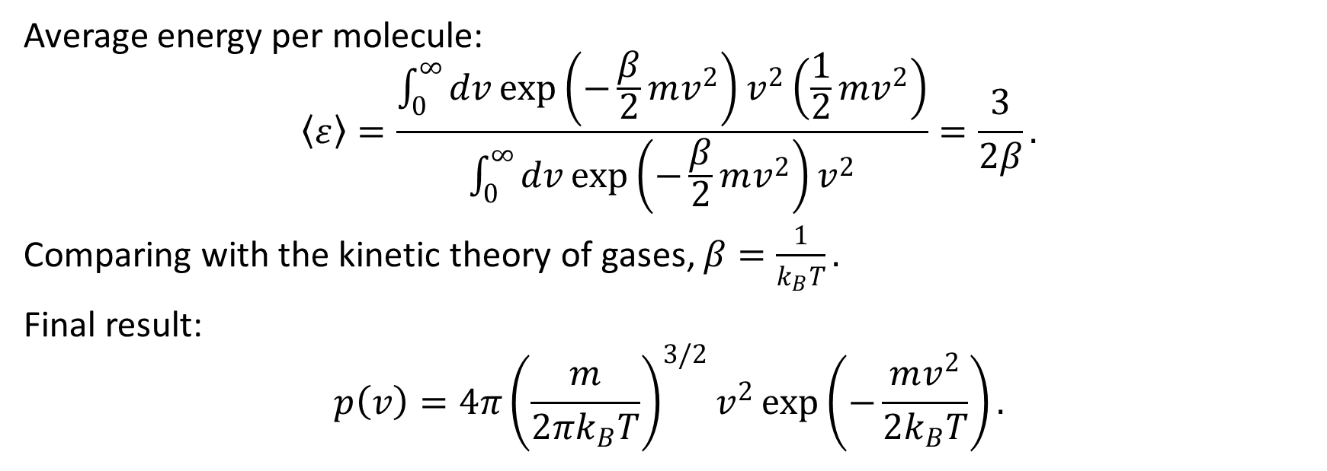
Average energy per molecule:
$$〈ε〉=\frac{\int_{0}^{∞}{dv}\exp\left(−\frac{β}{2}mv^{2}\right)v^{2}\left({\frac{1}{2}mv}^{2}\right)}{\int_{0}^{∞}{dv}\exp\left(−\frac{β}{2}mv^{2}\right)v^{2}}=\frac{3}{2β}.$$
Comparing with the kinetic theory of gases, $β=\frac{1}{k_{B}T}.$
Final result:
$$p\left(v\right)=4π{\left(\frac{m}{2πk_{B}T}\right)}^{3/2}v^{2}\exp\left(−\frac{mv^{2}}{2k_{B}T}\right).$$

Slide 13


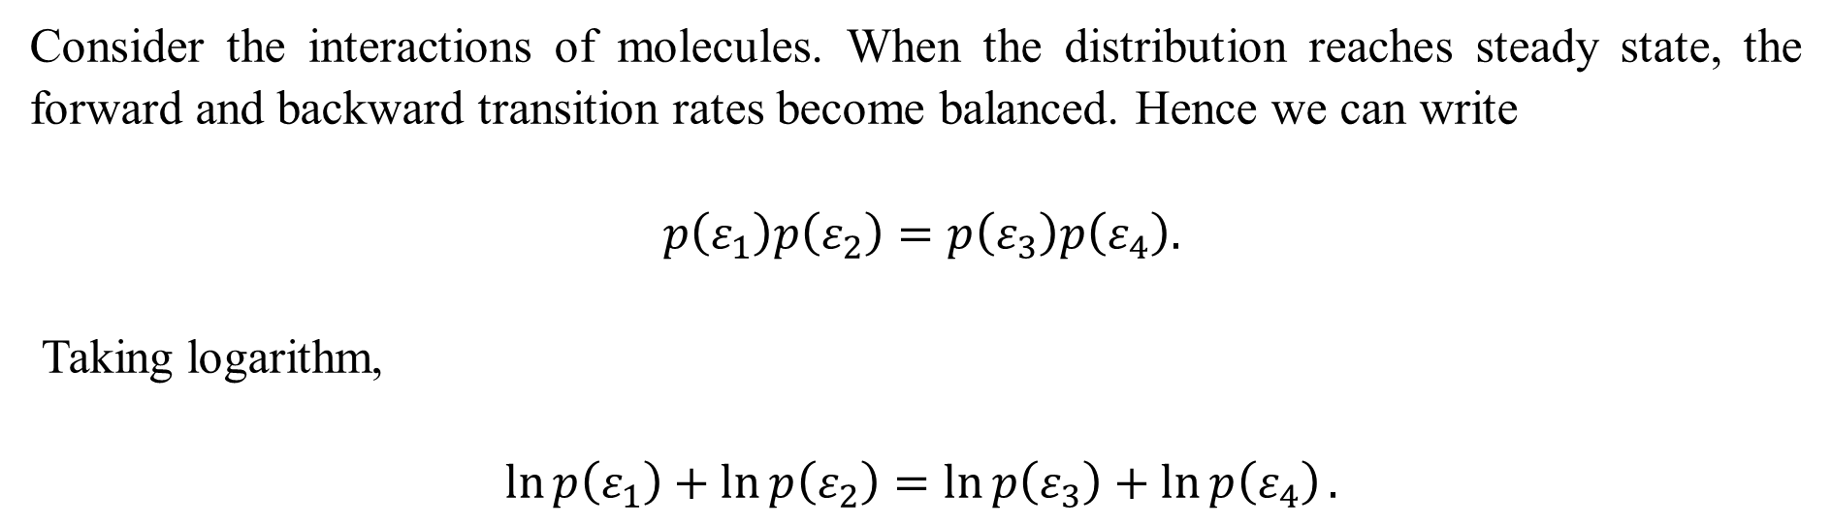


An Intuitive Argument for the Boltzmann Distribution
$$ε_{1}$$
$$ε_{3}$$
$$ε_{2}$$
$$ε_{4}$$
Consider the interactions of molecules. When the distribution reaches steady state, the forward and backward transition rates become balanced. Hence we can write
$p\left(ε_{1}\right)p\left(ε_{2}\right)=p\left(ε_{3}\right)p\left(ε_{4}\right).$
Taking logarithm,
$\ln{p\left(ε_{1}\right)}+\ln{p\left(ε_{2}\right)}=\ln{p\left(ε_{3}\right)}+\ln{p\left(ε_{4}\right)}.$

Slide 14
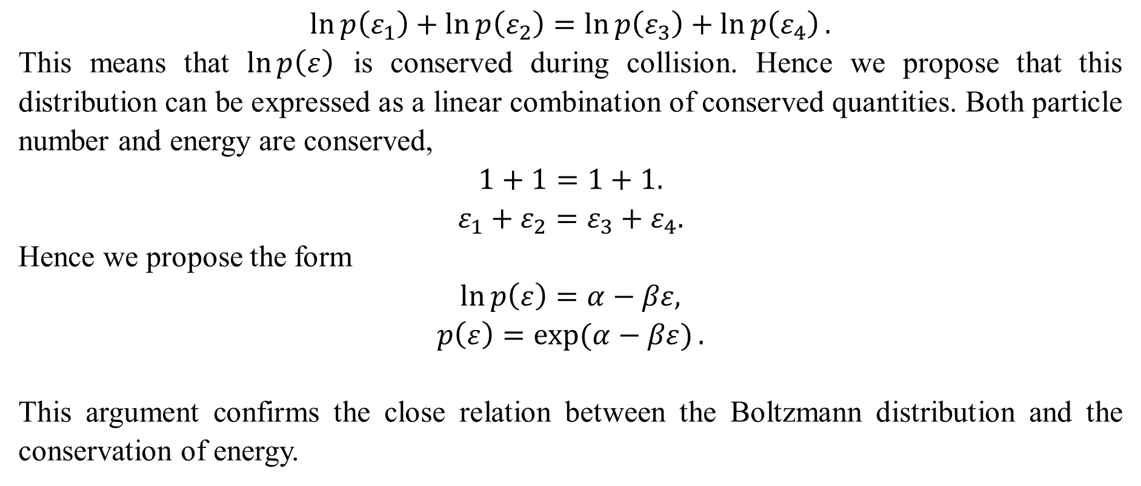
Argument from the Conserved Quantities
$$\ln{p\left(ε_{1}\right)}+\ln{p\left(ε_{2}\right)}=\ln{p\left(ε_{3}\right)}+\ln{p\left(ε_{4}\right)}.$$
This means that $\ln{p\left(ε\right)}$ is conserved during collision. Hence we propose that this distribution can be expressed as a linear combination of conserved quantities. Both particle number and energy are conserved,
$$1+1=1+1.$$
$$ε_{1}+ε_{2}=ε_{3}+ε_{4}.$$
Hence we propose the form
$$\ln{p\left(ε\right)}=α−βε,$$
$$p\left(ε\right)=\exp{(α−βε)}.$$
This argument confirms the close relation between the Boltzmann distribution and the conservation of energy.

Slide 15
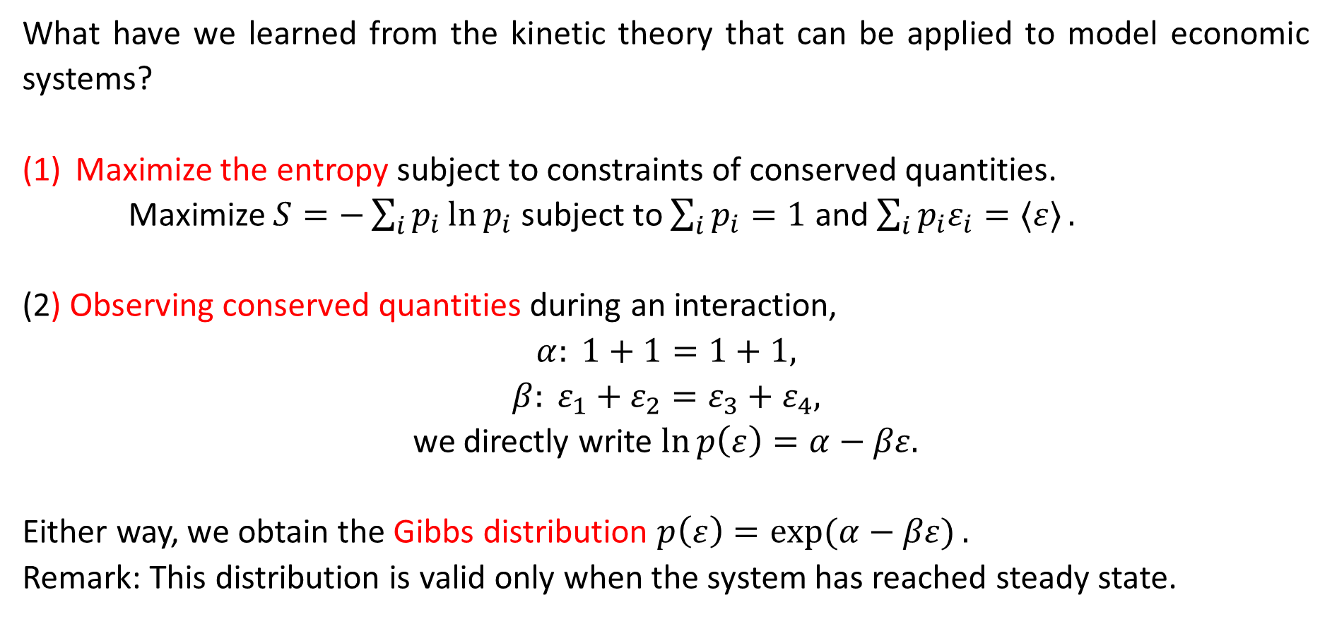
Summary
What have we learned from the kinetic theory that can be applied to model economic systems?
Maximize the entropy subject to constraints of conserved quantities.
Maximize $S=−\sum_{i}{p_{i}\ln{p_{i}}}$ subject to $\sum_{i}{p_{i}=1}$ and $\sum_{i}{p_{i}ε_{i}=〈ε〉}.$
(2) Observing conserved quantities during an interaction,
$$α: 1+1=1+1,$$
$$β: ε_{1}+ε_{2}=ε_{3}+ε_{4},$$
we directly write $\ln{p\left(ε\right)}=α−βε.$
Either way, we obtain the Gibbs distribution $p\left(ε\right)=\exp{(α−βε)}.$
Remark: This distribution is valid only when the system has reached steady state.

Slide 16
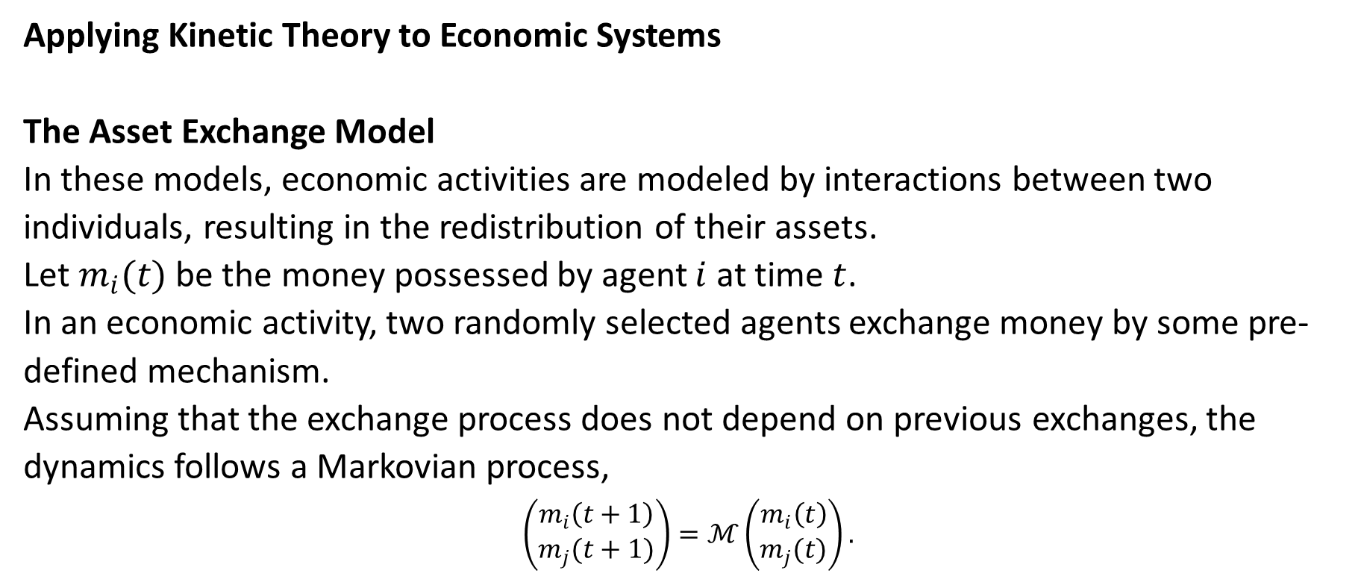
9.2 The Asset Exchange Model of Wealth Distribution
Applying Kinetic Theory to Economic Systems
The Asset Exchange Model
In these models, economic activities are modeled by interactions between two individuals, resulting in the redistribution of their assets.
Let $m_{i}(t)$ be the money possessed by agent $i$ at time $t$.
In an economic activity, two randomly selected agents exchange money by some pre-defined mechanism.
Assuming that the exchange process does not depend on previous exchanges, the dynamics follows a Markovian process,
$$\left(\begin{matrix}m_{i}\left(t+1\right) \\ m_{j}(t+1)\end{matrix}\right)=ℳ\left(\begin{matrix}m_{i}\left(t\right) \\ m_{j}(t)\end{matrix}\right).$$

Slide 17
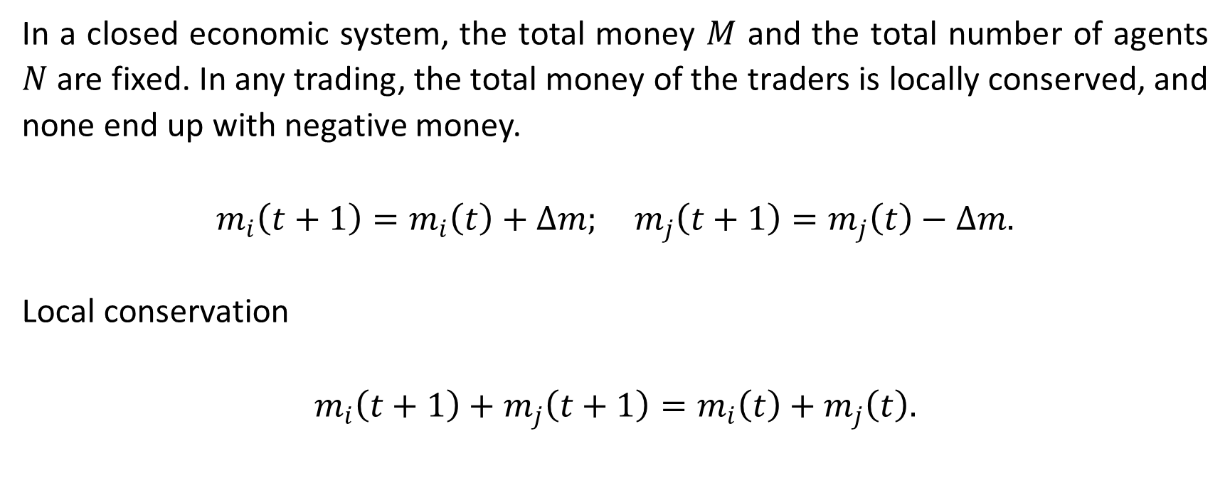
Conservation of Money
In a closed economic system, the total money $M$ and the total number of agents $N$ are fixed. In any trading, the total money of the traders is locally conserved, and none end up with negative money.
$$m_{i}\left(t+1\right)=m_{i}\left(t\right)+Δm; m_{j}\left(t+1\right)=m_{j}\left(t\right)−Δm.$$
Local conservation
$$m_{i}\left(t+1\right)+m_{j}\left(t+1\right)=m_{i}\left(t\right)+m_{j}\left(t\right).$$

Slide 18
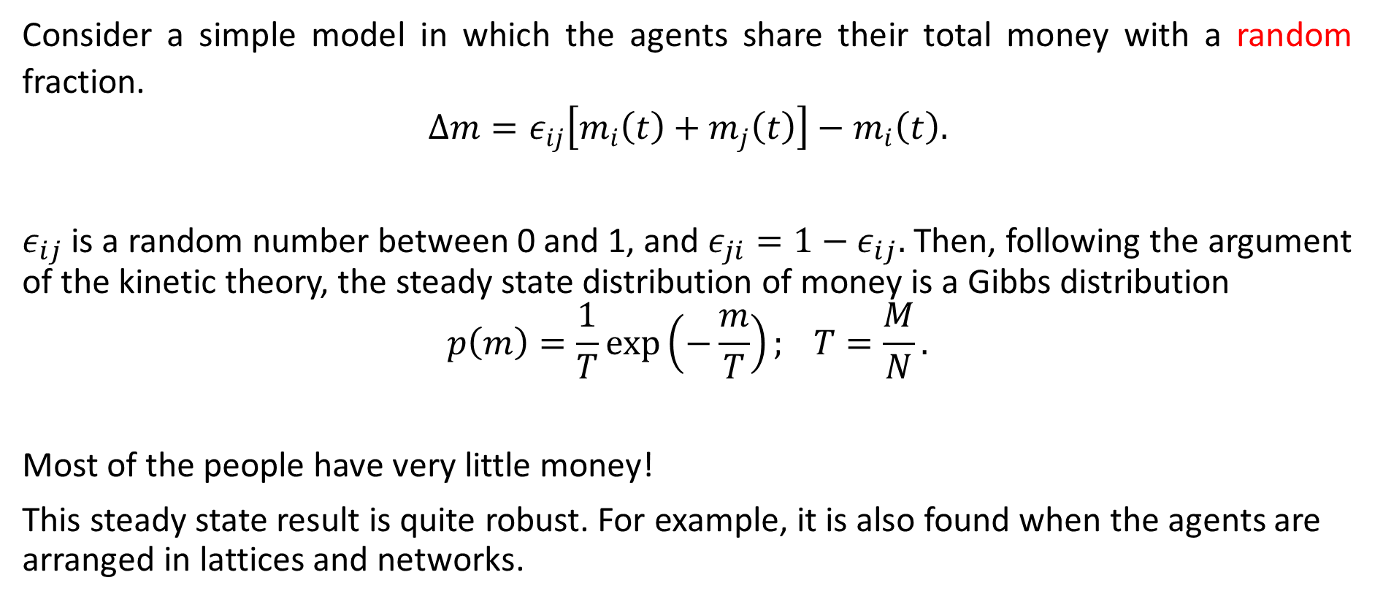
Random Sharing Model
Consider a simple model in which the agents share their total money with a random fraction.
$$Δm=ε_{ij}\left[m_{i}\left(t\right)+m_{j}\left(t\right)\right]−m_{i}\left(t\right).$$
$ε_{ij}$ is a random number between 0 and 1, and $ε_{ji}=1−ε_{ij}.$ Then, following the argument of the kinetic theory, the steady state distribution of money is a Gibbs distribution
$$p\left(m\right)=\frac{1}{T}\exp\left(−\frac{m}{T}\right); T=\frac{M}{N}.$$
Most of the people have very little money!
This steady state result is quite robust. For example, it is also found when the agents are arranged in lattices and networks.

Slide 19
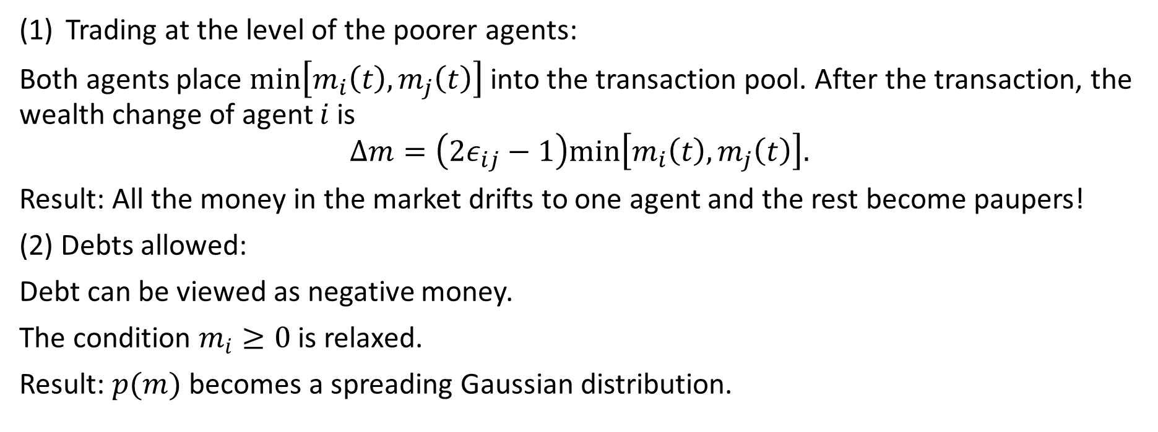
Other Versions (1)
Trading at the level of the poorer agents:
Both agents place $min\left[m_{i}\left(t\right),m_{j}\left(t\right)\right]$ into the transaction pool. After the transaction, the wealth change of agent $i$ is
$$Δm=\left(2ε_{ij}−1\right)min\left[m_{i}\left(t\right),m_{j}\left(t\right)\right].$$
Result: All the money in the market drifts to one agent and the rest become paupers!
(2) Debts allowed:
Debt can be viewed as negative money.
The condition $m_{i}≥0$ is relaxed.
Result: $p(m)$ becomes a spreading Gaussian distribution.

Slide 20
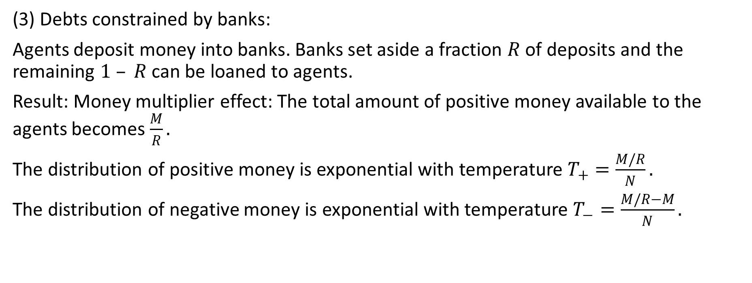
Other Versions (2)
(3) Debts constrained by banks:
Agents deposit money into banks. Banks set aside a fraction $R$ of deposits and the remaining $1 – R$ can be loaned to agents.
Result: Money multiplier effect: The total amount of positive money available to the agents becomes $\frac{M}{R}.$
The distribution of positive money is exponential with temperature $T_{+}=\frac{M/R}{N}.$
The distribution of negative money is exponential with temperature $T_{−}=\frac{M/R−M}{N}.$

Slide 21
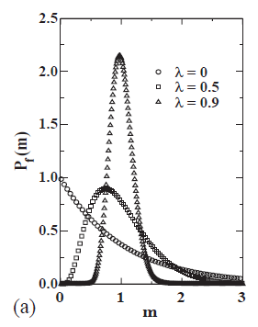
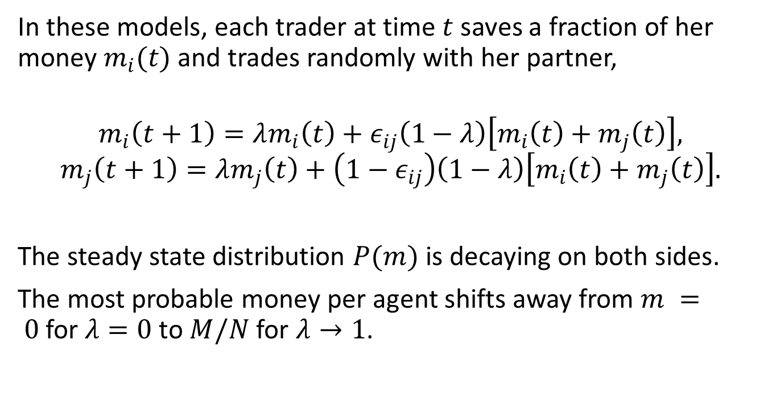
Models with Uniform Savings¹
In these models, each trader at time $t$saves a fraction of her money $m_{i}(t)$ and trades randomly with her partner,
$$m_{i}\left(t+1\right)=λm_{i}\left(t\right)+ε_{ij}\left(1−λ\right)\left[m_{i}\left(t\right)+m_{j}\left(t\right)\right],$$
$$m_{j}\left(t+1\right)=λm_{j}\left(t\right)+\left(1−ε_{ij}\right)\left(1−λ\right)\left[m_{i}\left(t\right)+m_{j}\left(t\right)\right].$$
The steady state distribution $P(m)$ is decaying on both sides.
The most probable money per agent shifts away from $m = 0$for $λ=0$ to $M/N$ for $λ→1$.
¹ Chatterjee A, Chakrabarti BK, Manna SS (2004). Pareto law in a kinetic model of market with random saving propensity. Physica A 335 155–163.

Slide 22
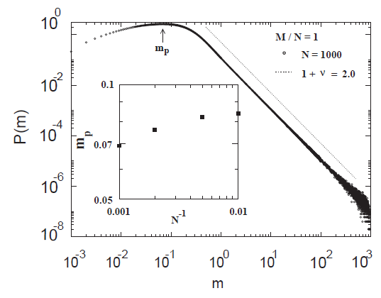
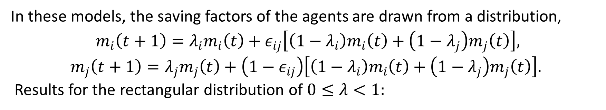
Models with Non-uniform Savings (1)
In these models, the saving factors of the agents are drawn from a distribution,
$m_{i}\left(t+1\right)=λ_{i}m_{i}\left(t\right)+ε_{ij}\left[\left(1−λ_{i}\right)m_{i}\left(t\right)+\left(1−λ_{j}\right)m_{j}\left(t\right)\right],$
$$m_{j}\left(t+1\right)=λ_{j}m_{j}\left(t\right)+\left(1−ε_{ij}\right)\left[\left(1−λ_{i}\right)m_{i}\left(t\right)+\left(1−λ_{j}\right)m_{j}\left(t\right)\right].$$
Results for the rectangular distribution of $0≤λ<1:$

Slide 23
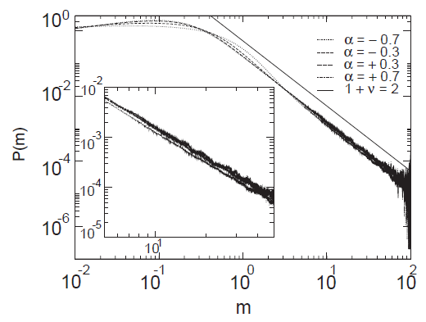
Models with Non-uniform Savings (2)
Results for the power law distribution $ρ(λ)∼λ^{α}$($0<λ<1$):
N = 100, M/N = 1

Slide 24
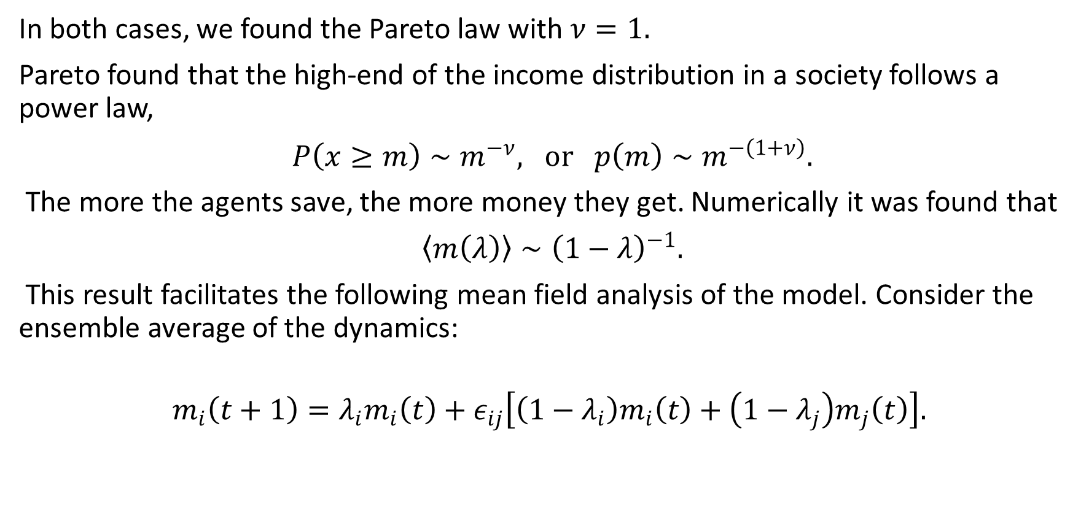
Mean-Field Approach (1)
In both cases, we found the Pareto law with $ν=1.$
Pareto found that the high-end of the income distribution in a society follows a power law,
$P\left(x≥m\right)∼m^{−ν}, or p\left(m\right)∼m^{−\left(1+ν\right)}.$
The more the agents save, the more money they get. Numerically it was found that
$〈m\left(λ\right)〉∼{\left(1−λ\right)}^{−1}.$
This result facilitates the following mean field analysis of the model. Consider the ensemble average of the dynamics:
$$m_{i}\left(t+1\right)=λ_{i}m_{i}\left(t\right)+ε_{ij}\left[\left(1−λ_{i}\right)m_{i}\left(t\right)+\left(1−λ_{j}\right)m_{j}\left(t\right)\right].$$

Slide 25
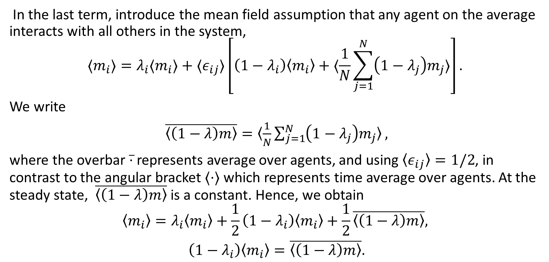
Mean-Field Approach (2)
In the last term, introduce the mean field assumption that any agent on the average interacts with all others in the system,
$$〈m_{i}〉=λ_{i}〈m_{i}〉+〈ε_{ij}〉\left[\left(1−λ_{i}\right)〈m_{i}〉+〈\frac{1}{N}\sum_{j=1}^{N}{\left(1−λ_{j}\right)m_{j}}〉\right].$$
We write
$\overline{〈\left(1−λ\right)m〉}=〈\frac{1}{N}\sum_{j=1}^{N}{\left(1−λ_{j}\right)m_{j}}〉,$
where the overbar $\overline{⋅}$ represents average over agents, and using $〈ε_{ij}〉=1/2$, in contrast to the angular bracket $〈⋅〉$ which represents time average over agents. At the steady state, $\overline{〈\left(1−λ\right)m〉}$ is a constant. Hence, we obtain
$$〈m_{i}〉=λ_{i}〈m_{i}〉+\frac{1}{2}\left(1−λ_{i}\right)〈m_{i}〉+\frac{1}{2}\overline{〈\left(1−λ\right)m〉},$$
$\left(1−λ_{i}\right)〈m_{i}〉=\overline{〈\left(1−λ\right)m〉}.$

Slide 26
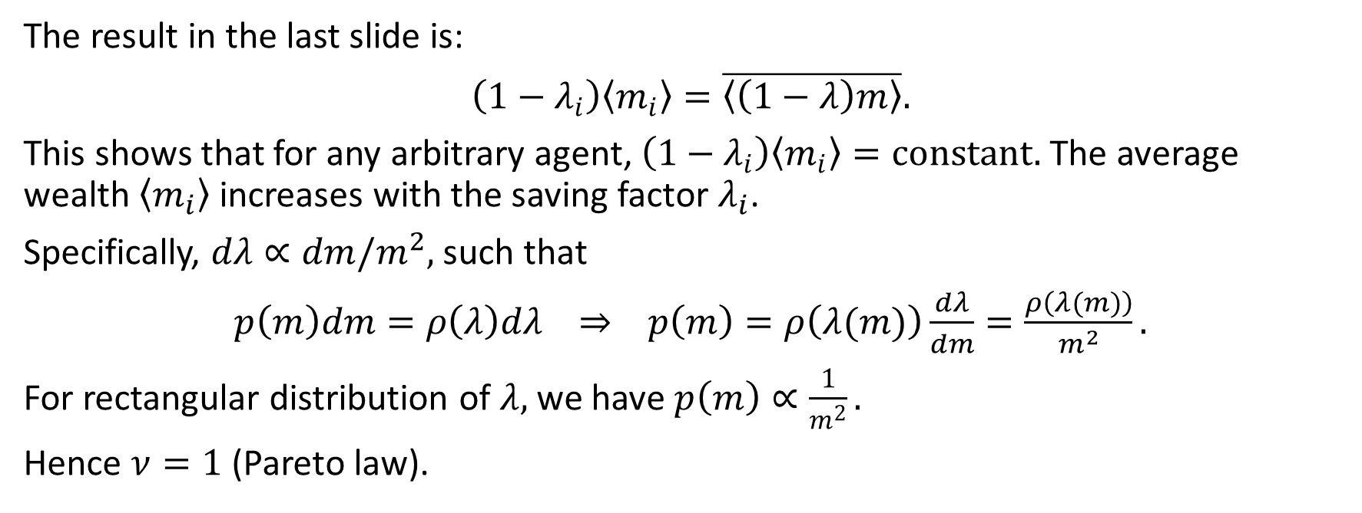
Mean-Field Approach (3)
The result in the last slide is:
$\left(1−λ_{i}\right)〈m_{i}〉=\overline{〈\left(1−λ\right)m〉}.$
This shows that for any arbitrary agent, $\left(1−λ_{i}\right)〈m_{i}〉=constant.$ The average wealth $〈m_{i}〉$ increases with the saving factor $λ_{i}$.
Specifically, $dλ∝dm/m^{2},$ such that
$p\left(m\right)dm=ρ\left(λ\right)dλ ⇒ p\left(m\right)=ρ\left(λ(m)\right)\frac{dλ}{dm}=\frac{ρ\left(λ(m)\right)}{m^{2}}.$
For rectangular distribution of $λ,$ we have $p\left(m\right)∝\frac{1}{m^{2}}.$
Hence $ν=1$ (Pareto law).

Slide 27
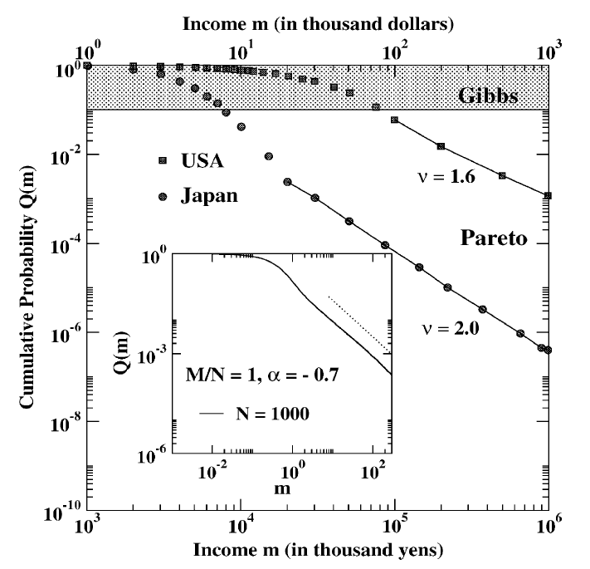
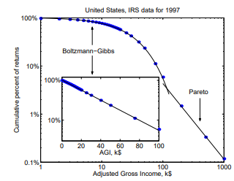
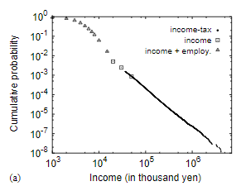
9.3 Comparison with Real Data^{2,3}
Low income range (>90% population): Gibbs-like distribution
High income range (<10% population): Pareto-like distribution
² Drăgulescu AA and Yakovenko VM (2001) Statistical Mechanics of Money, Income, and Wealth: A Short Survey. Physica A 299 213.
³ Aoyama H, Souma W, and Fujiwara Y (2003) Growth and fluctuations of personal and company’s income. Physica A 324 352.

Slide 28
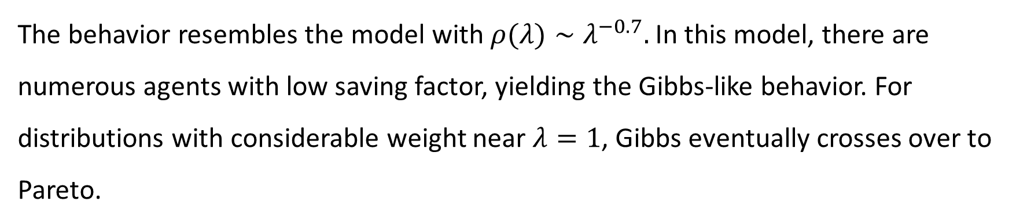
Resemblance with a Model
The behavior resembles the model with $ρ(λ)∼λ^{−0.7}.$In this model, there are numerous agents with low saving factor, yielding the Gibbs-like behavior. For distributions with considerable weight near $λ=1$, Gibbs eventually crosses over to Pareto.

Slide 29
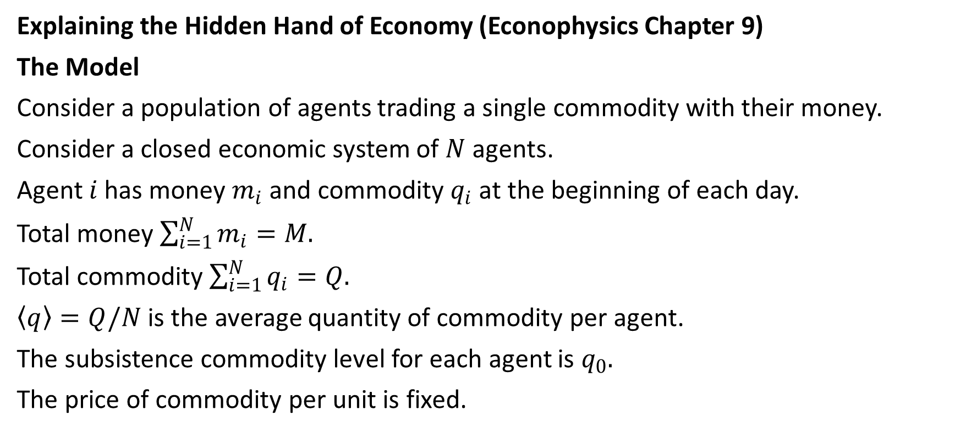
9.4 A Minimal Model of Interacting Selfish Agents⁴
Explaining the Hidden Hand of Economy (Econophysics Chapter 9)
The Model
Consider a population of agents trading a single commodity with their money.
Consider a closed economic system of $N$ agents.
Agent $i$ has money $m_{i}$ and commodity $q_{i}$ at the beginning of each day.
Total money $\sum_{i=1}^{N}{m_{i}}=M.$
Total commodity $\sum_{i=1}^{N}{q_{i}}=Q.$
$〈q〉=Q/N$ is the average quantity of commodity per agent.
The subsistence commodity level for each agent is $q_{0}.$
The price of commodity per unit is fixed.
⁴ Chakraborti A et al. (2001) A self-organising model of market with single commodity. Physica A 297 253–259.

Slide 30
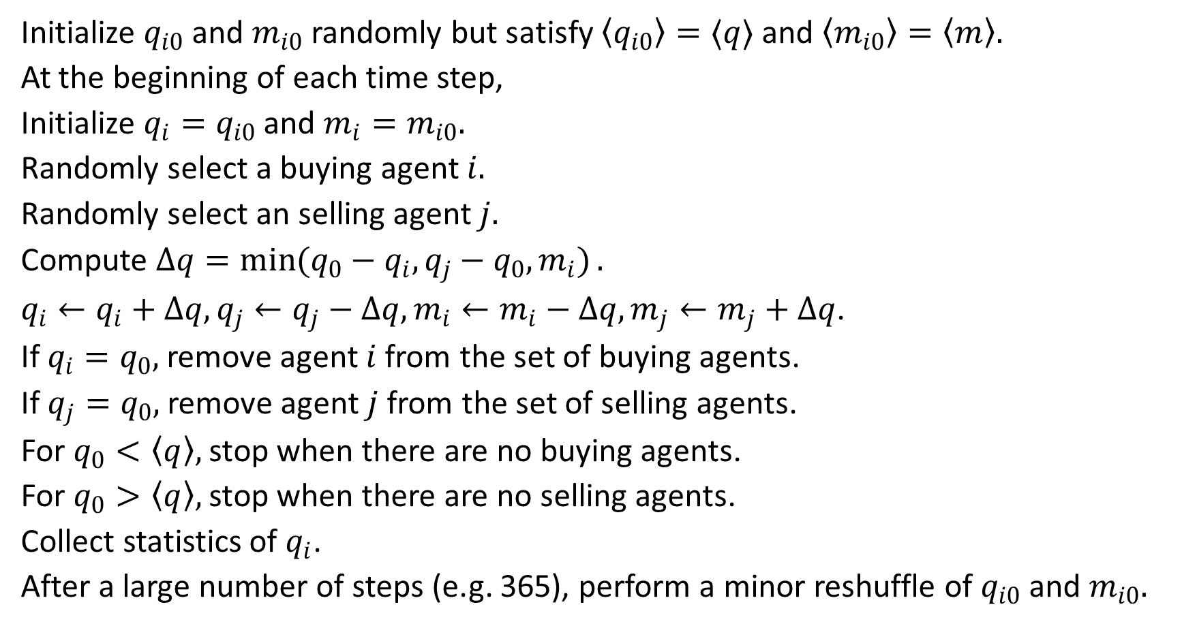
Algorithm
Initialize $q_{i0}$ and $m_{i0}$randomly but satisfy $〈q_{i0}〉=〈q〉$ and $〈m_{i0}〉=〈m〉.$
At the beginning of each time step,
Initialize $q_{i}=q_{i0}$ and $m_{i}=m_{i0}.$
Randomly select a buying agent $i.$
Randomly select an selling agent $j.$
Compute $Δq=\min{(q_{0}−q_{i},q_{j}−q_{0},m_{i})}.$
$q_{i}←q_{i}+Δq, q_{j}←q_{j}−Δq, m_{i}←m_{i}−Δq, m_{j}←m_{j}+Δq$.
If $q_{i}=q_{0},$ remove agent $i$ from the set of buying agents.
If $q_{j}=q_{0},$ remove agent $j$ from the set of selling agents.
For $q_{0}<〈q〉,$ stop when there are no buying agents.
For $q_{0}>〈q〉,$ stop when there are no selling agents.
Collect statistics of $q_{i}$.
After a large number of steps (e.g. 365), perform a minor reshuffle of $q_{i0}$ and $m_{i0}.$

Slide 31
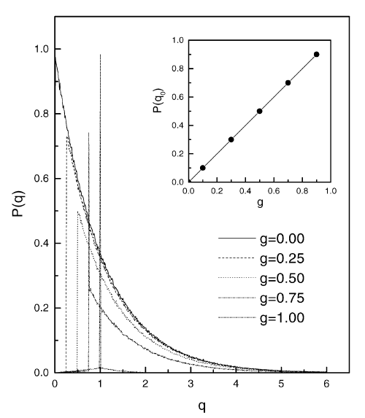

Unlimited Money Supply and Limited Supply of Commodity
Case 1: Satisfied case ($g<1)$
Commodity distribution after trading:
$$P\left(q\right)=\left\{\begin{matrix}delta function & q=q_{0}, \\ exponential function & q>q_{0}.\end{matrix}\right.$$

Slide 32
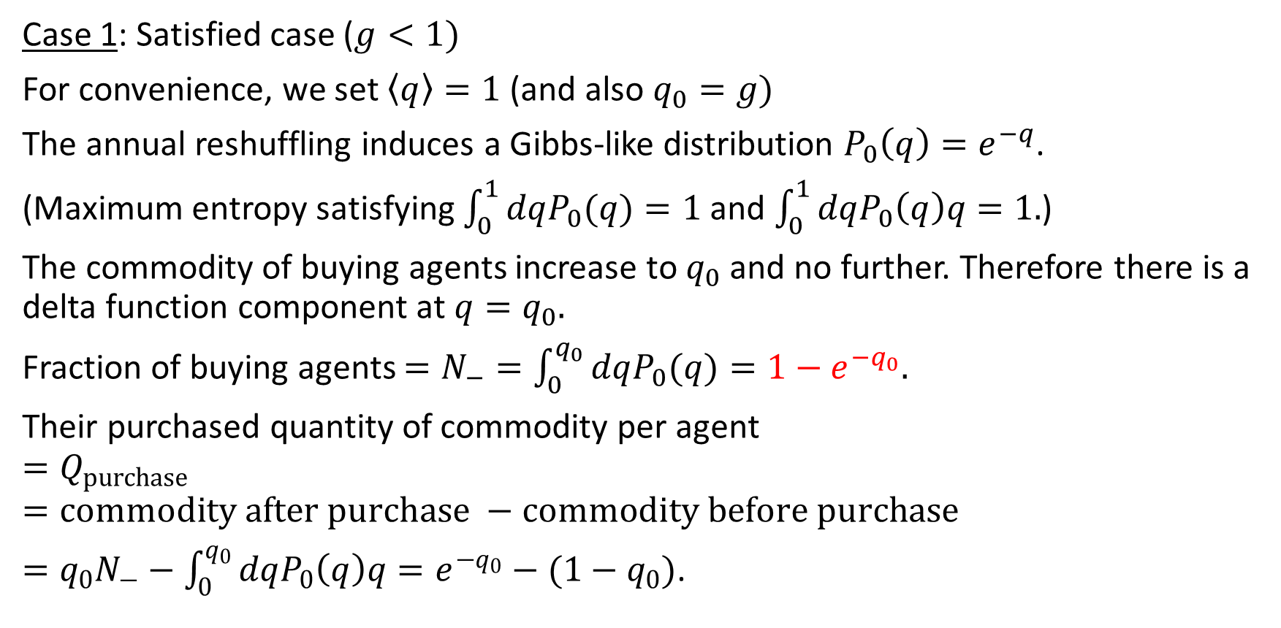

Buying Agents Ending Up with $q=q_{0}$
Case 1: Satisfied case ($g<1)$
For convenience, we set $〈q〉=1$ (and also $q_{0}=g)$
The annual reshuffling induces a Gibbs-like distribution $P_{0}\left(q\right)=e^{−q}$.
(Maximum entropy satisfying $\int_{0}^{1}{dqP_{0}(q)}=1$ and $\int_{0}^{1}{dqP_{0}\left(q\right)q}=1.$)
The commodity of buying agents increase to $q_{0}$ and no further. Therefore there is a delta function component at $q=q_{0}.$
Fraction of buying agents $=N_{−}=\int_{0}^{q_{0}}{dqP_{0}(q)}=1−e^{−q_{0}}.$
Their purchased quantity of commodity per agent
$$=Q_{purchase}$$
$$=commodity after purchase −commodity before purchase$$
$=q_{0}N_{−}−\int_{0}^{q_{0}}{dqP_{0}\left(q\right)q}=e^{−q_{0}}−(1−q_{0})$.

Slide 33
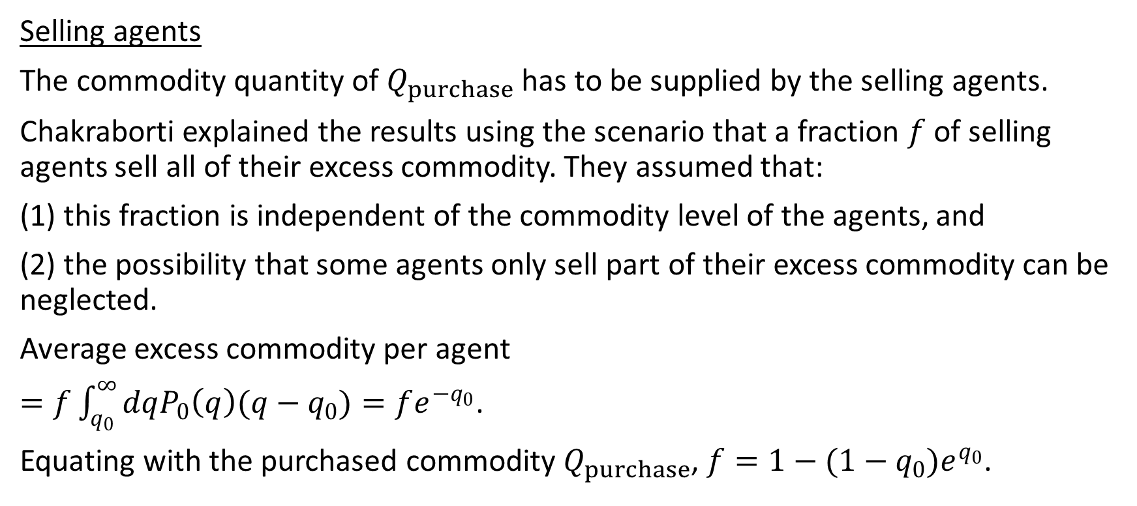

Selling Agents Ending Up with $q=q_{0}$ (1)
Selling agents
The commodity quantity of $Q_{purchase}$ has to be supplied by the selling agents.
Chakraborti explained the results using the scenario that a fraction $f$ of selling agents sell all of their excess commodity. They assumed that:
(1) this fraction is independent of the commodity level of the agents, and
(2) the possibility that some agents only sell part of their excess commodity can be neglected.
Average excess commodity per agent
$=f\int_{q_{0}}^{∞}{dqP_{0}\left(q\right)(q−q_{0})}=fe^{−q_{0}}$.
Equating with the purchased commodity $Q_{purchase}$, $f=1−(1−q_{0})e^{q_{0}}$.

Slide 34
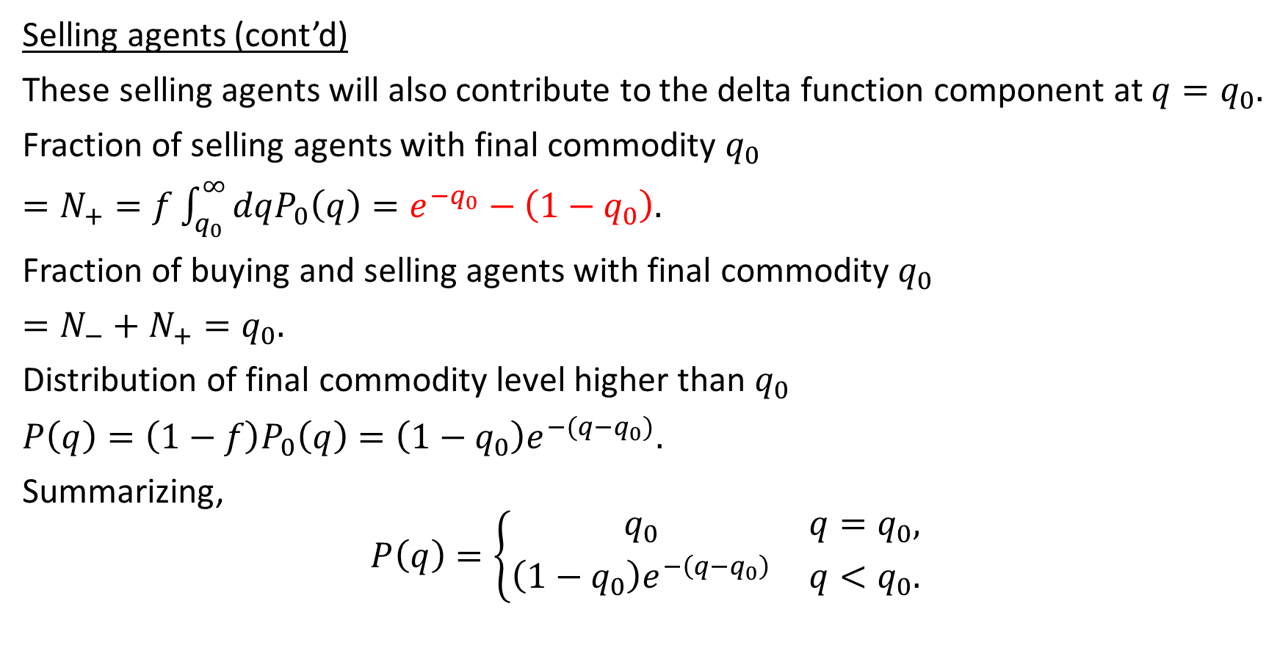

Selling Agents Ending Up with $q=q_{0}$ (2)
Selling agents (cont’d)
These selling agents will also contribute to the delta function component at $q=q_{0}.$
Fraction of selling agents with final commodity $q_{0}$
$=N_{+}=f\int_{q_{0}}^{∞}{dqP_{0}\left(q\right)}=e^{−q_{0}}−\left(1−q_{0}\right).$
Fraction of buying and selling agents with final commodity $q_{0}$
$=N_{−}+N_{+}=q_{0}.$
Distribution of final commodity level higher than $q_{0}$
$P\left(q\right)=\left(1−f\right)P_{0}\left(q\right)=\left(1−q_{0}\right)e^{−(q−q_{0})}.$
Summarizing,
$$P\left(q\right)=\left\{\begin{matrix}q_{0} & q=q_{0}, \\ \left(1−q_{0}\right)e^{−\left(q−q_{0}\right)} & q<q_{0}.\end{matrix}\right.$$

Slide 35
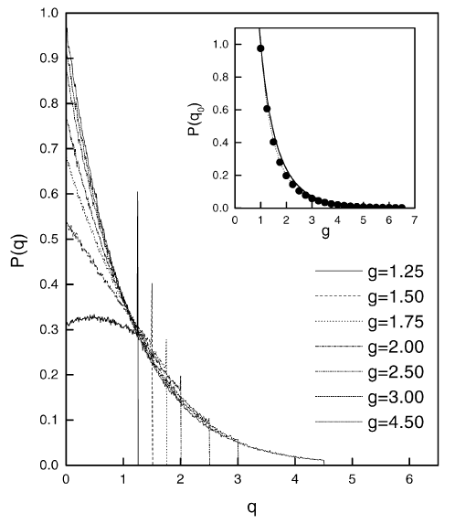


Case 2: Frustrated Case ($g>1$)
Case 1: Frustrated case ($g>1)$
Commodity distribution after trading:
$P\left(q\right)=\left\{\begin{matrix}delta function & q=q_{0}, \\ exponential function & q<q_{0}.\end{matrix}\right.$

Slide 36
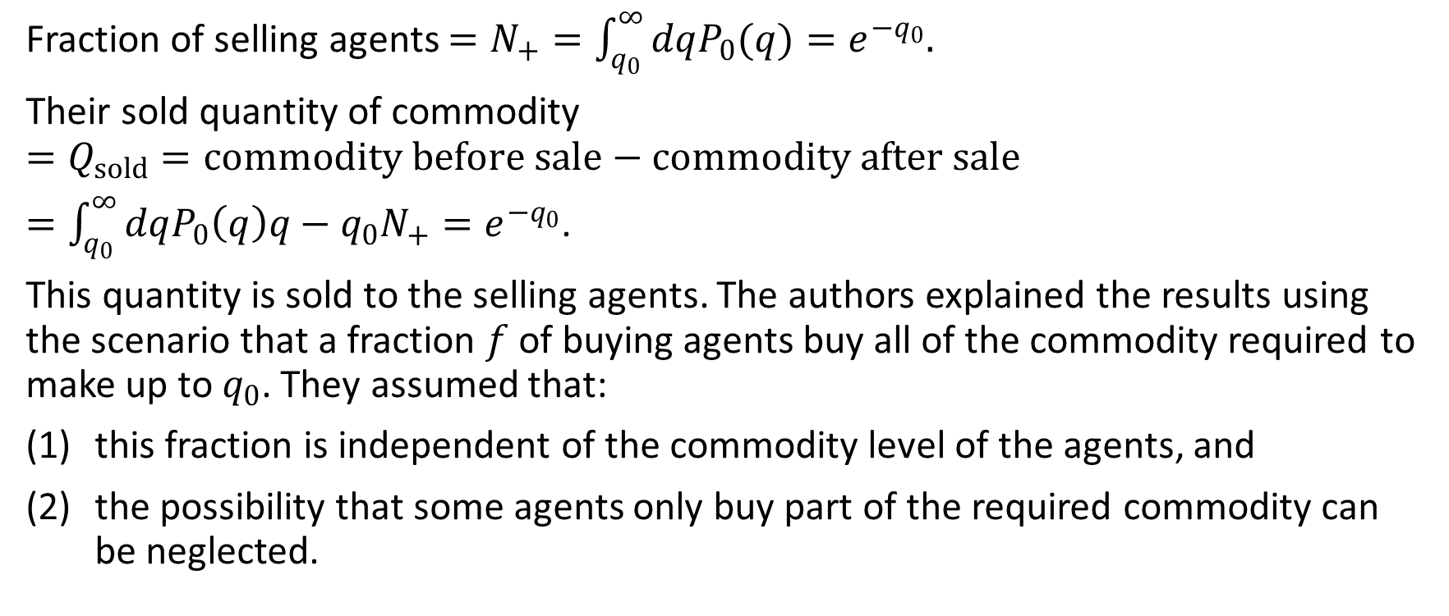

Selling Agents Ending Up with $q=q_{0}$
Fraction of selling agents $=N_{+}=\int_{q_{0}}^{∞}{dqP_{0}(q)}=e^{−q_{0}}.$
Their sold quantity of commodity
$$=Q_{sold}=commodity before sale−commodity after sale$$
$=\int_{q_{0}}^{∞}{dqP_{0}\left(q\right)q}−q_{0}N_{+}=e^{−q_{0}}$.
This quantity is sold to the selling agents. The authors explained the results using the scenario that a fraction $f$ of buying agents buy all of the commodity required to make up to $q_{0}$. They assumed that:
this fraction is independent of the commodity level of the agents, and
the possibility that some agents only buy part of the required commodity can be neglected.

Slide 37
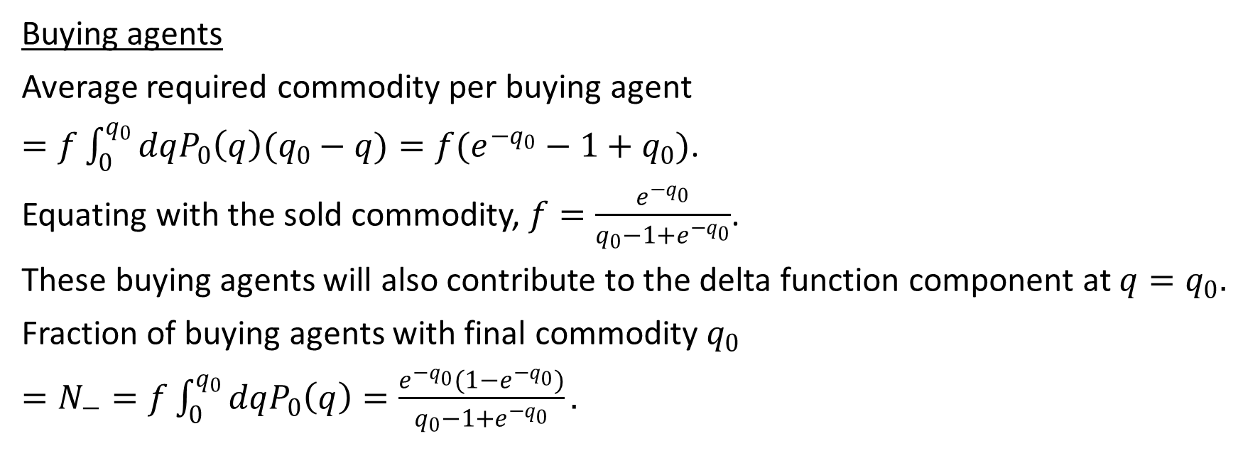
Buying Agents Ending Up with $q=q_{0}$
Buying agents
Average required commodity per buying agent
$=f\int_{0}^{q_{0}}{dqP_{0}\left(q\right)(q_{0}−q)}=f(e^{−q_{0}}−1+q_{0})$.
Equating with the sold commodity, $f=\frac{e^{−q_{0}}}{q_{0}−1+e^{−q_{0}}}$.
These buying agents will also contribute to the delta function component at $q=q_{0}.$
Fraction of buying agents with final commodity $q_{0}$
$=N_{−}=f\int_{0}^{q_{0}}{dqP_{0}\left(q\right)}=\frac{e^{−q_{0}}(1−e^{−q_{0}})}{q_{0}−1+e^{−q_{0}}}.$

Slide 38
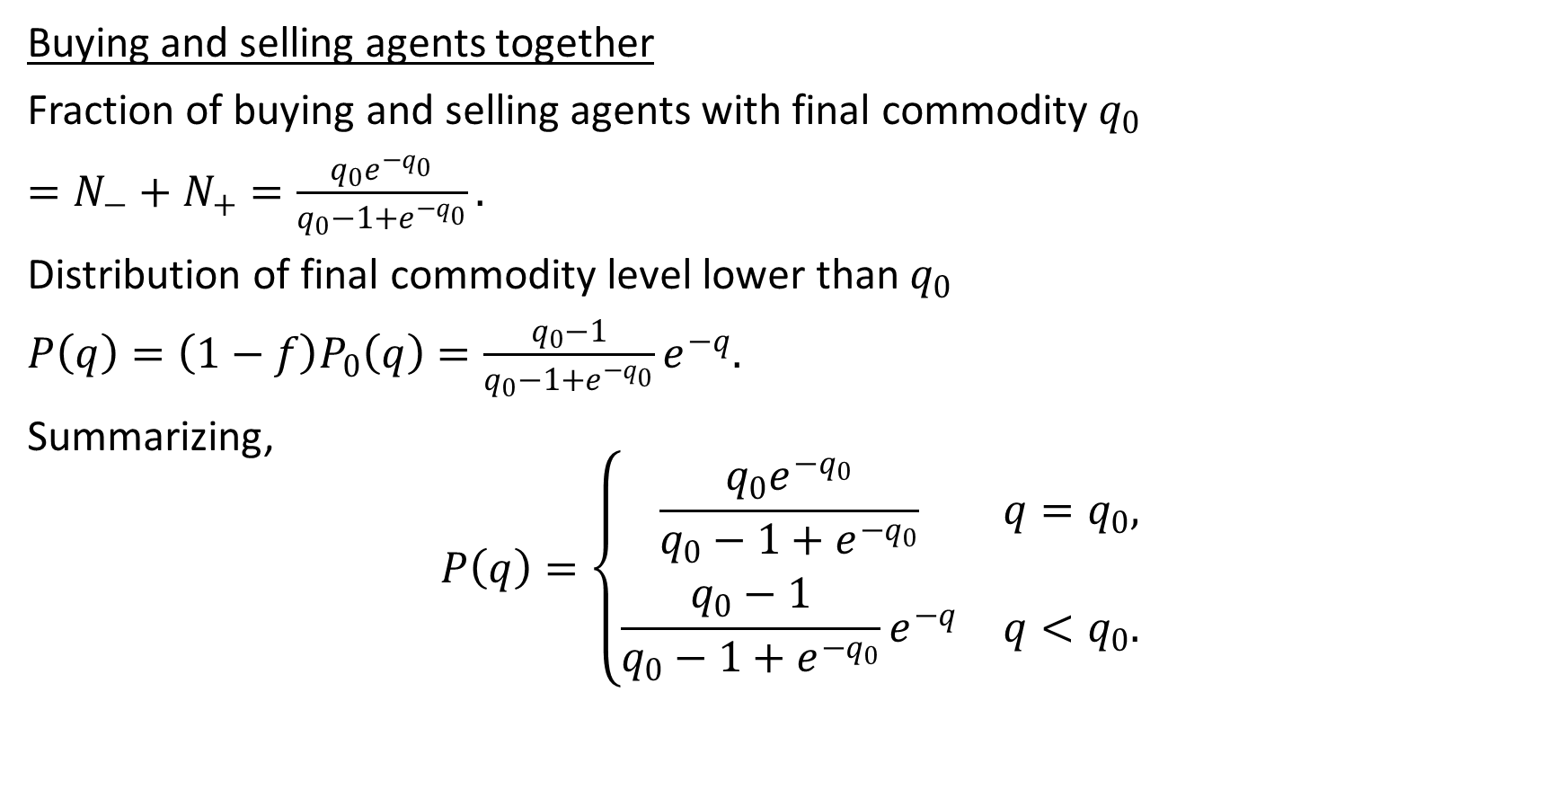

All Agents Ending Up with $q=q_{0}$
Buying and selling agents together
Fraction of buying and selling agents with final commodity $q_{0}$
$=N_{−}+N_{+}=\frac{q_{0}e^{−q_{0}}}{q_{0}−1+e^{−q_{0}}}.$
Distribution of final commodity level lower than $q_{0}$
$P\left(q\right)=\left(1−f\right)P_{0}\left(q\right)=\frac{q_{0}−1}{q_{0}−1+e^{−q_{0}}}e^{−q}.$
Summarizing,
$$P\left(q\right)=\left\{\begin{matrix}\frac{q_{0}e^{−q_{0}}}{q_{0}−1+e^{−q_{0}}} & q=q_{0}, \\ \frac{q_{0}−1}{q_{0}−1+e^{−q_{0}}}e^{−q} & q<q_{0}.\end{matrix}\right.$$

Slide 39
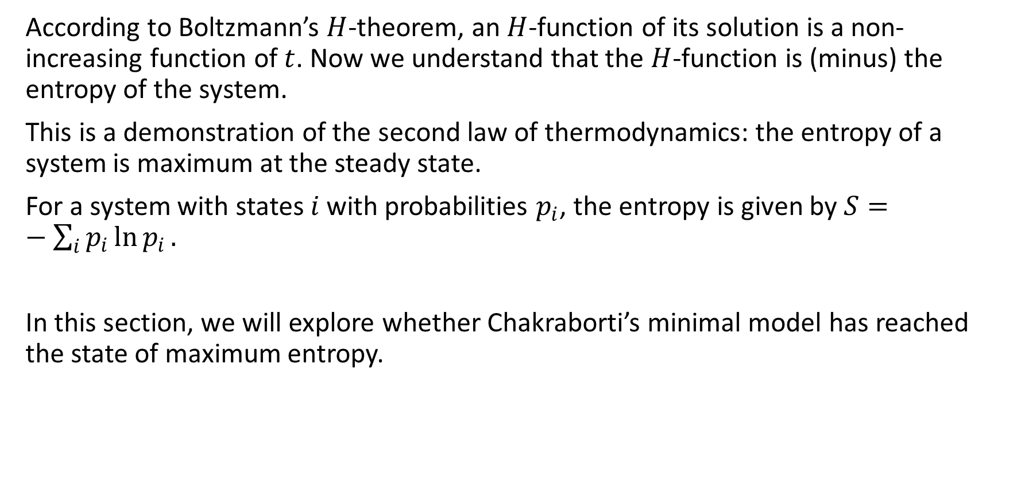
How Far Is the Entropy Maximized?
According to Boltzmann’s $H$-theorem, an $H$-function of its solution is a non-increasing function of $t$. Now we understand that the $H$-function is (minus) the entropy of the system.
This is a demonstration of the second law of thermodynamics: the entropy of a system is maximum at the steady state.
For a system with states $i$ with probabilities $p_{i}$, the entropy is given by $S=−\sum_{i}{p_{i}\ln{p_{i}}.}$
In this section, we will explore whether Chakraborti’s minimal model has reached the state of maximum entropy.

Slide 40
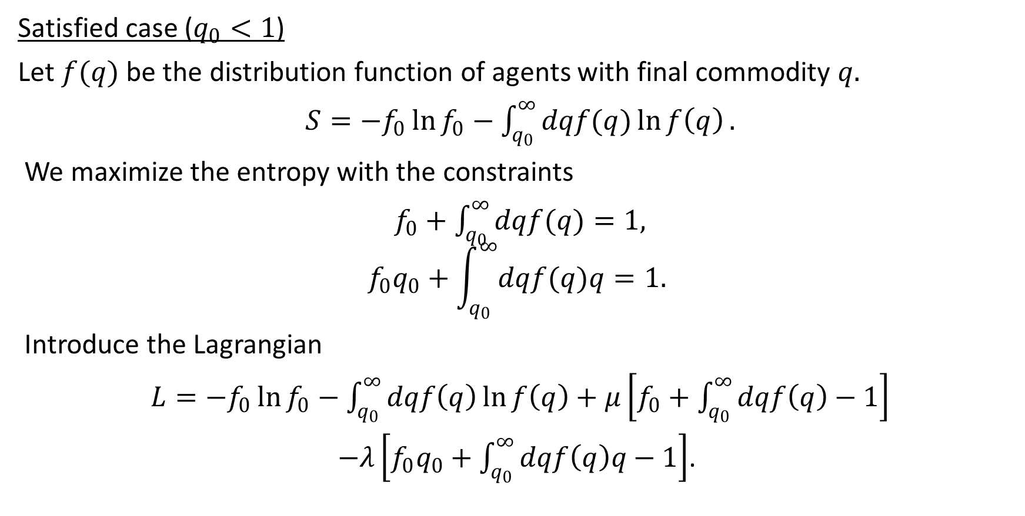
Maximum Entropy Solution of Satisfied Case (1)
Satisfied case ($q_{0}<1$)
Let $f(q)$ be the distribution function of agents with final commodity $q.$
$S=−f_{0}\ln{f_{0}}−\int_{q_{0}}^{∞}{dqf(q)\ln{f\left(q\right)}}.$
We maximize the entropy with the constraints
$f_{0}+\int_{q_{0}}^{∞}{dqf(q)}=1,$
$$f_{0}q_{0}+\int_{q_{0}}^{∞}{dqf(q)q}=1.$$
Introduce the Lagrangian
$L=−f_{0}\ln{f_{0}}−\int_{q_{0}}^{∞}{dqf\left(q\right)\ln{f\left(q\right)}}+μ\left[f_{0}+\int_{q_{0}}^{∞}{dqf\left(q\right)}−1\right]$
$−λ\left[f_{0}q_{0}+\int_{q_{0}}^{∞}{dqf\left(q\right)q}−1\right]$.

Slide 41
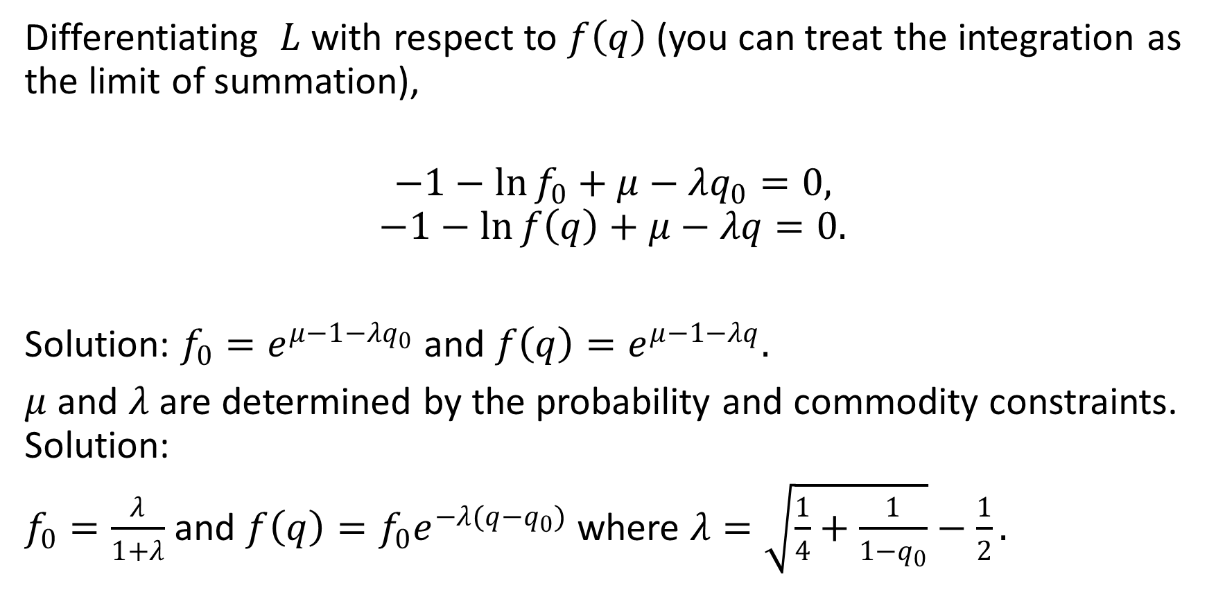
Maximum Entropy Solution of Satisfied Case (2)
Differentiating $L$ with respect to $f\left(q\right)$ (you can treat the integration as the limit of summation),
$$−1−\ln{f_{0}}+μ−λq_{0}=0,$$
$$−1−\ln{f\left(q\right)}+μ−λq=0.$$
Solution: $f_{0}=e^{μ−1−λq_{0}}$ and $f\left(q\right)=e^{μ−1−λq}.$
$μ$ and $λ$ are determined by the probability and commodity constraints. Solution:
$f_{0}=\frac{λ}{1+λ}$ and $f\left(q\right)=f_{0}e^{−λ(q−q_{0})}$where $λ=\sqrt{\frac{1}{4}+\frac{1}{1−q_{0}}}−\frac{1}{2}.$

Slide 42
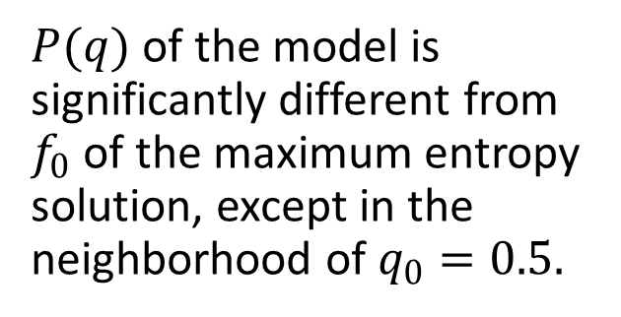
Maximum Entropy Solution of Satisfied Case (3)
$P(q)$ of the model is significantly different from $f_{0}$ of the maximum entropy solution, except in the neighborhood of $q_{0}=0.5.$

Slide 43
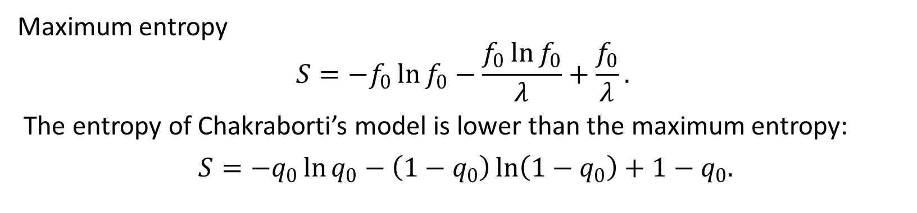
Entropy of Satisfied Case
Maximum entropy
$$S=−f_{0}\ln{f_{0}}−\frac{f_{0}\ln{f_{0}}}{λ}+\frac{f_{0}}{λ}.$$
The entropy of Chakraborti’s model is lower than the maximum entropy:
$S=−q_{0}\ln{q_{0}}−\left(1−q_{0}\right)\ln\left(1−q_{0}\right)+1−q_{0}.$

Slide 44
Discussion
Although Chakraborti’s model was obtained by transaction processes analogous to the kinetic theory of gases that obeys the Boltzmann equation, the final commodity distribution has not reached the maximum entropy.
This is probably due to the restrictions of the allowed transactions. For example, transactions within buying agents and transactions within selling agents are not allowed. Also, large step sizes may not lead to the equilibrium state.
This also implies that Chakraborti’s model is not stable. If additional transaction mechanisms were present, the model may evolve to states with higher entropy.

Slide 45
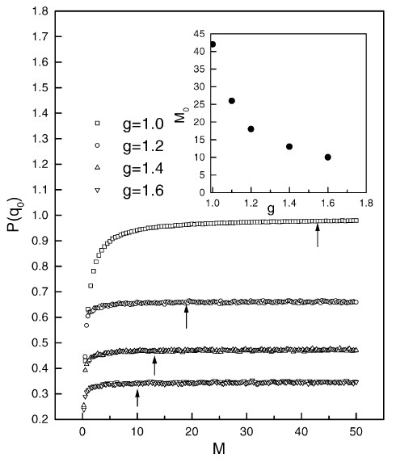
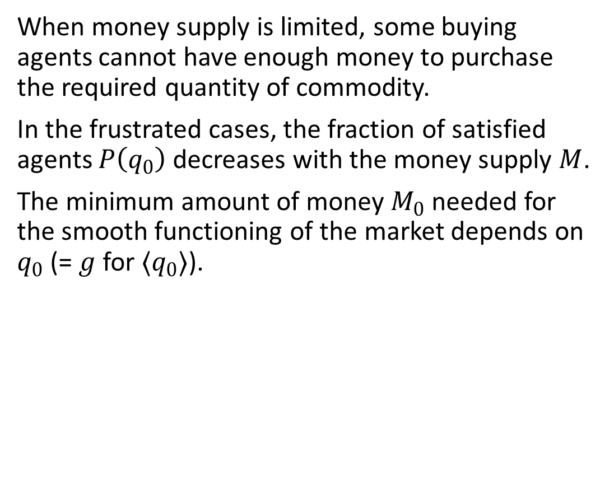
Limited Money Supply and Limited Supply of Commodity
When money supply is limited, some buying agents cannot have enough money to purchase the required quantity of commodity.
In the frustrated cases, the fraction of satisfied agents $P\left(q_{0}\right)$ decreases with the money supply $M$.
The minimum amount of money $M_{0}$ needed for the smooth functioning of the market depends on $q_{0}$ (= $g$ for $〈q_{0}〉$).

